Slide 1
Intelligent Unit of Hybrid Energy System
Supervisor:
Engr. Aamer Munir
Group Members:
Arsalan Saghir (i11-0466)
Arsalan Ahmed (i11-0504)
Notes:
Arsalan Saghir

Slide 2
Motivation and Background
Integration of different intermittent and available power sources
Tackle unannounced load shedding
Real Time Data Acquisition of Incoming Power
Step towards a smart home
Notes:
Arsalan Saghir

Slide 3
Objective
Utilizing full potential of an intermittent source
Free electricity
Cost reduction in installation
User Friendly system
Notes:
Arsalan Saghir

Slide 4
Main Block Diagram
MODIFIED
UART FOR
Notes:
Arsalan Ahmed

Slide 5
FYPs
Integration of hybrid system
Implementation of Intelligent Unit
Contruction and Implementaion of Load Unit
Simulation of hybrid system
Notes:
Arsalan Ahmed

Slide 6
Deliverables OF FYP-1
Completed:
Study of different Hybrid systems
Completion of code required for controlling the hybrid system.
Software implementation of our Intelligent Unit.
Notes:
Arsalan Ahmed

Slide 7
Deliverables OF FYP-2
Completed:
Improvement in previous Design of Hybrid system
Data logging of incoming Power sources.
Visual Presentation of Data Acquisition
Accounted Loadsheding Schedule
Time based switching
Notes:
Arsalan Saghir

Slide 8
Switching Conditions (revised)
There were 4 parameters on which our switching conditions are based
  Charge Controller Output Power
  Battery level
  Grid Voltage
  Load consumption
On these parameters we had to come up with various real life scenarios on which our circuit should be able to make judgment on which source to pick in a scenario.
Notes:
Arsalan Saghir

Slide 9
Conditions | GRID | AC Charger | Charge Controller | Inverter
Charge Controller Power>load consumption Battery Level >Critical Value Grid > 0 | LOW | LOW | HIGH | HIGH
Charge Controller Power<load consumption Grid > Min. Grid Volt. Grid < Max. Grid Volt.
Battery Level > Minimum_Battery_level | HIGH | LOW | HIGH | LOW
Battery Level <= Minimum_Battery_level | HIGH | HIGH | LOW | LOW
Charge Controller Power<load consumption Grid > Min. Grid Volt. Grid < Max. Grid Volt.
Battery Level < = Minimum_Battery_level | HIGH | HIGH | LOW | LOW
Battery Level > Minimum_Battery_level | HIGH | LOW | HIGH | LOW
Charge Controller Power>load consumption Battery Level <Critical Value Grid Not Available | LOW | LOW | HIGH | HIGH
Charge Controller Power<load consumption Battery Level <Critical Value Grid Not Available | LOW | LOW | HIGH | LOW
Charge Controller Power>load consumption Battery Level <Critical Value Grid > Min. Grid Volt. Grid < Max. Grid Volt | HIGH | LOW | HIGH | LOW
Charge Controller Power<load consumption Battery Level >Critical Value Grid Not Available | LOW | LOW | HIGH | HIGH
Notes:
Arsalan Ahmed

Slide 10
Notes:
Saghir

Slide 11
Real time clock
RTC used is DS-1307.
Provides us with data and time
Present as well future value
Automatically synchronizes with DATE and TIME on computer.
Notes:
Ahmed

Slide 12
Data Logging
Creating Data logs of incoming electrical power (all sources).
Hardware used
  Arduino Due
  2GB SD card
  SD card module
Communication port SPI
Text file vs “.csv” format
Comma Separated Value
Column format
Notes:
Arsalan sahir

Slide 13
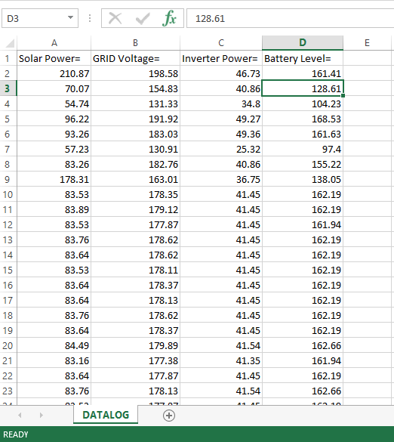
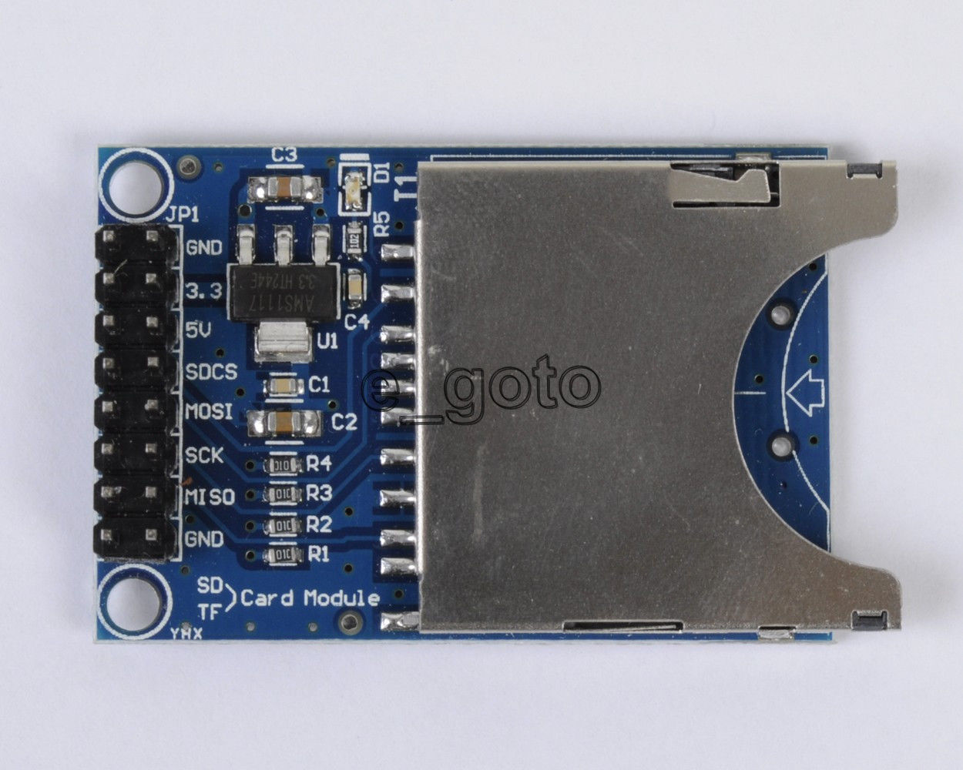
Data Logging
Format
SD Card Module
Notes:
Arsalan Saghir

Slide 14
Data Logging
Notes:
Arsalan Ahmed

Slide 15
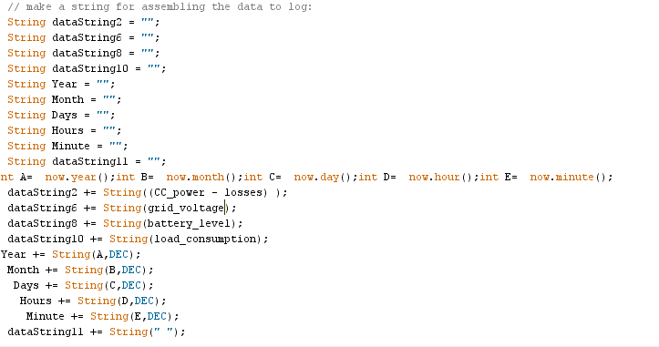
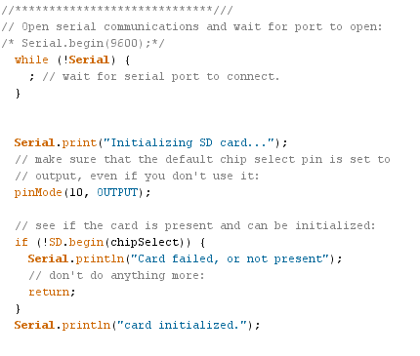
Data Logging
VOID LOOP
VOID SETUP
Notes:
Arsalan Ahmed

Slide 16
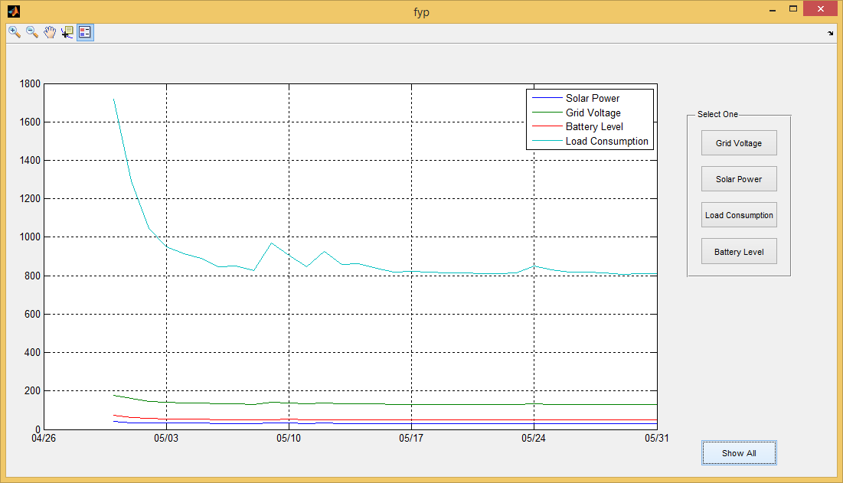
GUI in MATLAB
Notes:
Arsalan Saghir

Slide 17
Announced Load Shedding
Our objective is to do switching on basis of past day load shedding schedule.
For thing we required RTC to generate time and date.
Check the Grid Voltage.
If Grid is off then save the initial time.
After Grid become available save that time as week
Set frame size of 55 minutes that is if has loadsheding occurred.
Save load shedding time according to load shedding period.
If on next day Load shedding time in that array matches the present time system will start charging batteries for that duration of load shedding.
Notes:
Arsalan Ahmed

Slide 18
Notes:
Arsalan Ahmed

Slide 19
Notes:
Arsalan Saghir

Slide 20
COST
ARDUINO MICRO-CONTROLLER = 3000Rs
SD Card Module = 500Rs
CD Card = 1500Rs
RTC Module = 250Rs
Notes:
Arsalan Ahmed

Slide 21
REFRENCES
Denis Lenardic. “Photovoltaic Hybrid Systems”
Internet: http://www.pvresources.com/PVSystems/HybridSystems.aspx , date updated* [April 17, 2015].
Belectric. “ Hybrid Systems combining PV with your Energy Source”
Internet: http://www.belectric.com/fileadmin/MASTER/pdf/brochures/BEL_SKW_Hybrid_Systems_EN_www.pdf date updated* [April 17, 2015].
Geetech. “Arduino SD card Module”
Internet: http://www.geeetech.com/wiki/index.php/Arduino_SD_card_Module ,
, date updated* [April 17, 2015].
GitHUB, “A fork of Jeelab's fantastic RTC library”
Internet: https://github.com/adafruit/RTClib date updated* [April 17, 2015].
“A brief overview of Allegro ACS712 current sensor” Internet: http://embedded-lab.com/blog/?p=4469
date updated* [April 17, 2015].

Slide 22
THANK YOU
ANY QUESTIONS !

